Slide 1

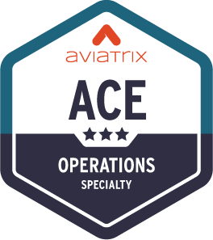
Secure Egress

Slide 2













Problem Statement
Private workloads need internet access
SaaS integration
Patching
Updates
NAT Gateway
Squid Proxy
Layer-7 Firewall
Layer-4 only
NACLs management
Hard to manage
Scale and HA issues
Overkill
Expensive
VPC
VPC
VPC
Internet gateway
Internet gateway
Internet gateway
Public subnet
Public subnet
Public subnet
NAT gateway
Firewall
Squid Proxy
Private subnet
Private subnet
Private subnet
Workloads
Workloads
Workloads

Slide 3




Aviatrix Secure Egress Filtering Feature
Internet
VPC
VPC
VNet

Slide 4


Aviatrix Secure Egress Filtering
Aviatrix
CoPilot
Activate the Egress
on the required VPCs/VNets
Internet
Centralized
Management
Aviatrix
Spoke Gateway
Aviatrix
Spoke Gateway
Aviatrix
Spoke Gateway
VPC
VPC
VNet
Distributed
Control
Distributed
Control
Distributed
Control

Slide 5
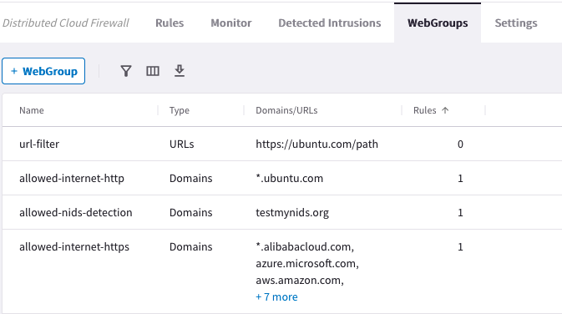

Aviatrix Secure Egress Filtering
Aviatrix
CoPilot
Internet
Centralized
Management
Egress Filtering
Policies with WebGroups
Domain Filter
Domain Filter
Domain Filter
*.github.com
updates.ubuntu.com
api.twillio.com
deny all
*.github.com
updates.ubuntu.com
api.saas.com
deny all
*.github.com
updates.ubuntu.com
api.google.com
deny all
Aviatrix
Spoke Gateway
Aviatrix
Spoke Gateway
Aviatrix
Spoke Gateway
VPC
VPC
VNet
Distributed
Control
Distributed
Control
Distributed
Control

Slide 6
Aviatrix Secure Egress Filtering
Aviatrix
CoPilot
Internet
Centralized
Management
Egress Filtering
Policies with WebGroups
Domain Filter
Domain Filter
Domain Filter
*.github.com
updates.ubuntu.com
api.twillio.com
deny all
*.github.com
updates.ubuntu.com
api.saas.com
deny all
*.github.com
updates.ubuntu.com
api.google.com
deny all
Aviatrix
Spoke Gateway
Aviatrix
Spoke Gateway
Aviatrix
Spoke Gateway
VPC
VPC
VNet
Distributed
Control
Filtered
Distributed
Control
Filtered
Distributed
Control
Filtered

Slide 7




Aviatrix Secure Egress Filtering Design Patterns
Stand-alone Spoke GW (Distributed)
Local Egress (Distributed)
with Aviatrix Spoke GW
Centralized Egress
with Aviatrix Transit GW
Egress on Spoke
Stand-alone Spoke Gateways
VPC
VPC
VPC
VPC
VPC
VPC
Spoke Gateways
Spoke Gateways
Spoke Gateways
Spoke Gateways
Transit VPC
Transit VPC
Transit Gateways
Transit Gateways
Egress on Transit

Slide 8
Zero Trust Network Access
There are two possible models:
DENY LIST MODEL (THREAT-CENTRIC MODEL):
allow all data to flow, except for exactly what you say should be stopped.
ALLOW LIST MODEL (TRUST-CENTRIC MODEL):
deny everything and only permit what you explicitly allow.

Slide 9
Tools for troubleshooting Egress

Slide 10
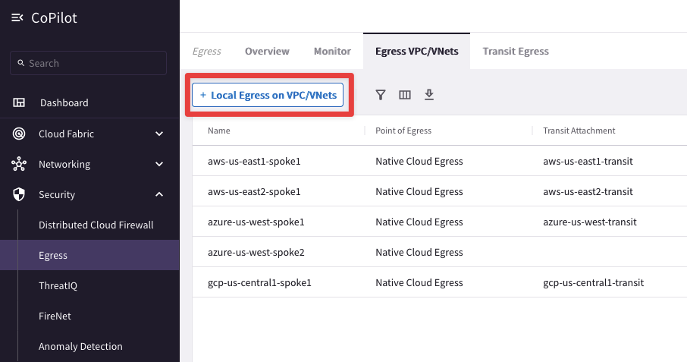
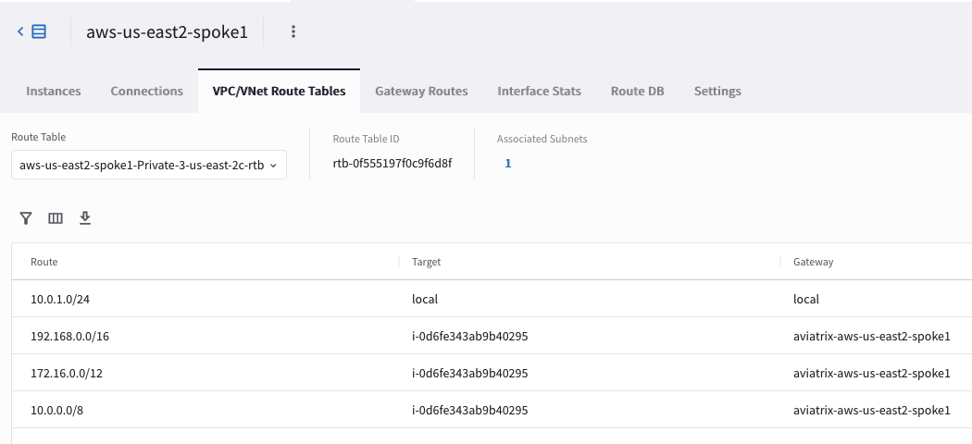
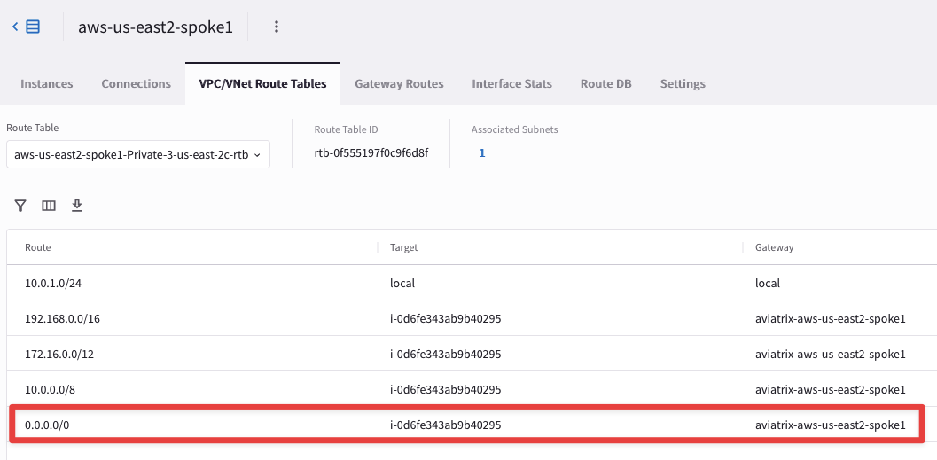
Enabling Egress
Adding Egress Control on VPC/VNet changes the default route on VPC/VNet to point to the Spoke Gateway and enables SNAT.
Egress Control also requires additional resources on the Spoke Gateway (i.e. scale up the VM size).
In addition to the Local route, the three RFC1918 routes, also a default route will be injected.

Slide 11
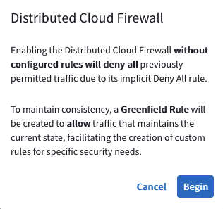
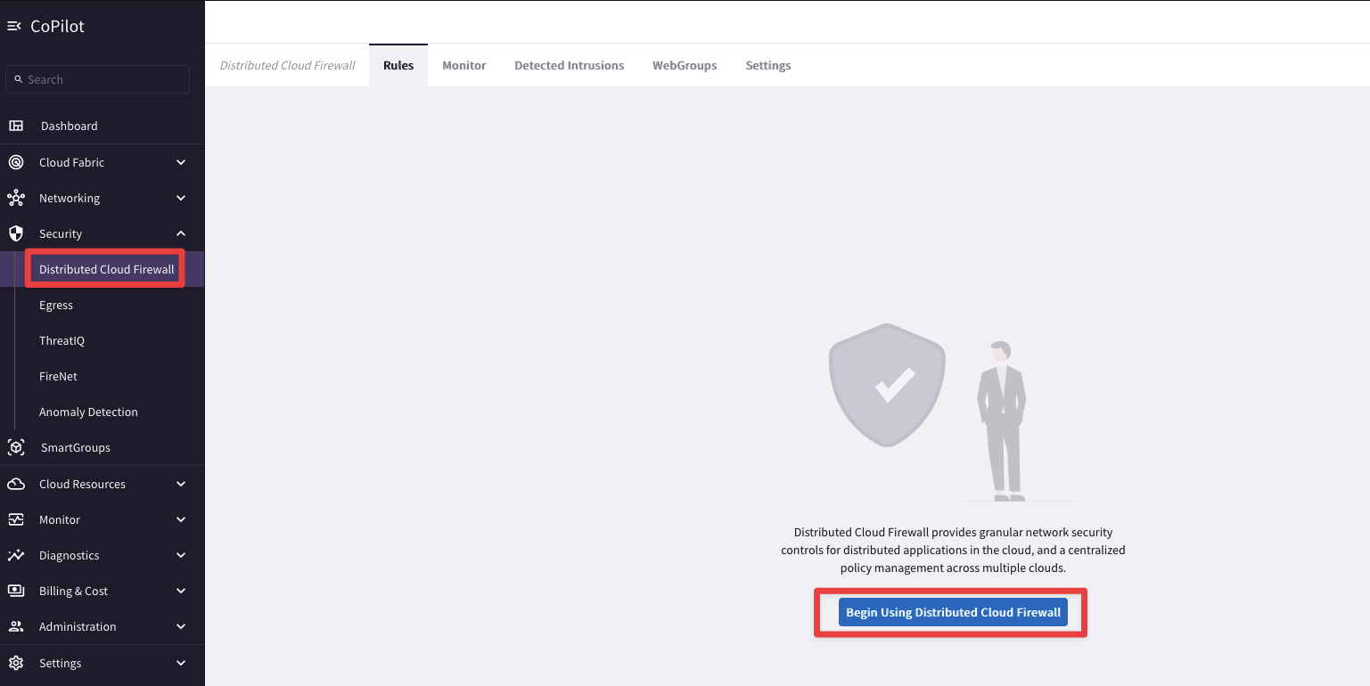
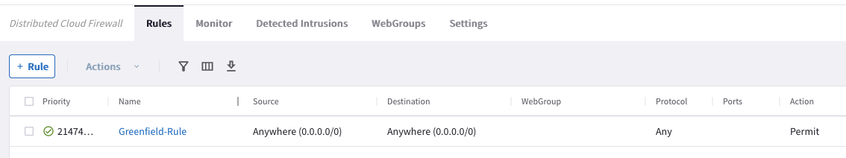
Adding Filtering/Monitoring feature to the Egress
The Egress control is part of the Distributed Cloud Firewall service.
The Egress control requires the activation of the Distributed Cloud Firewall.
The Greenfield-Rule is automatically added to allow all kind of traffic.

Slide 12
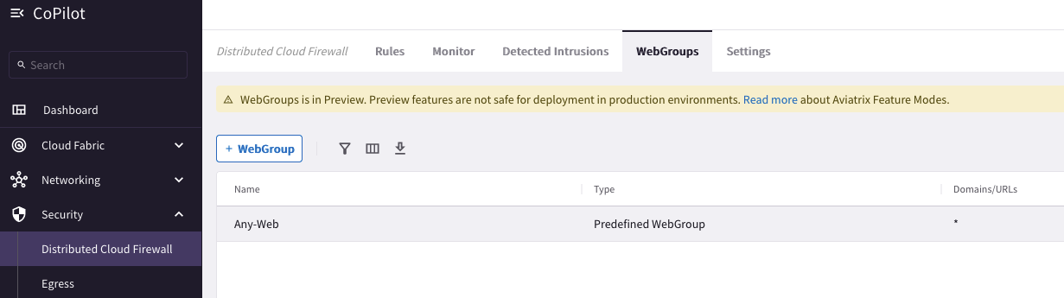
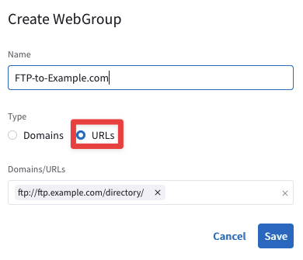
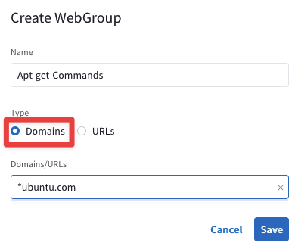
WebGroup Creation
WebGroups are groupings of domains and URLs, inserted into Distributed Cloud Firewall rules, that filter (and provide security to) Internet-bound traffic.
When you navigate to Security > Distributed Cloud Firewall > WebGroups, a predefined WebGroup, Any-Web, has already been created for you,
This is an "allow-all" WebGroup that you must select in a Distributed Cloud Firewall rule if you do not want to limit the Internet-bound traffic for that rule, but you still want to log the FQDNs that are being accessed.

Slide 13
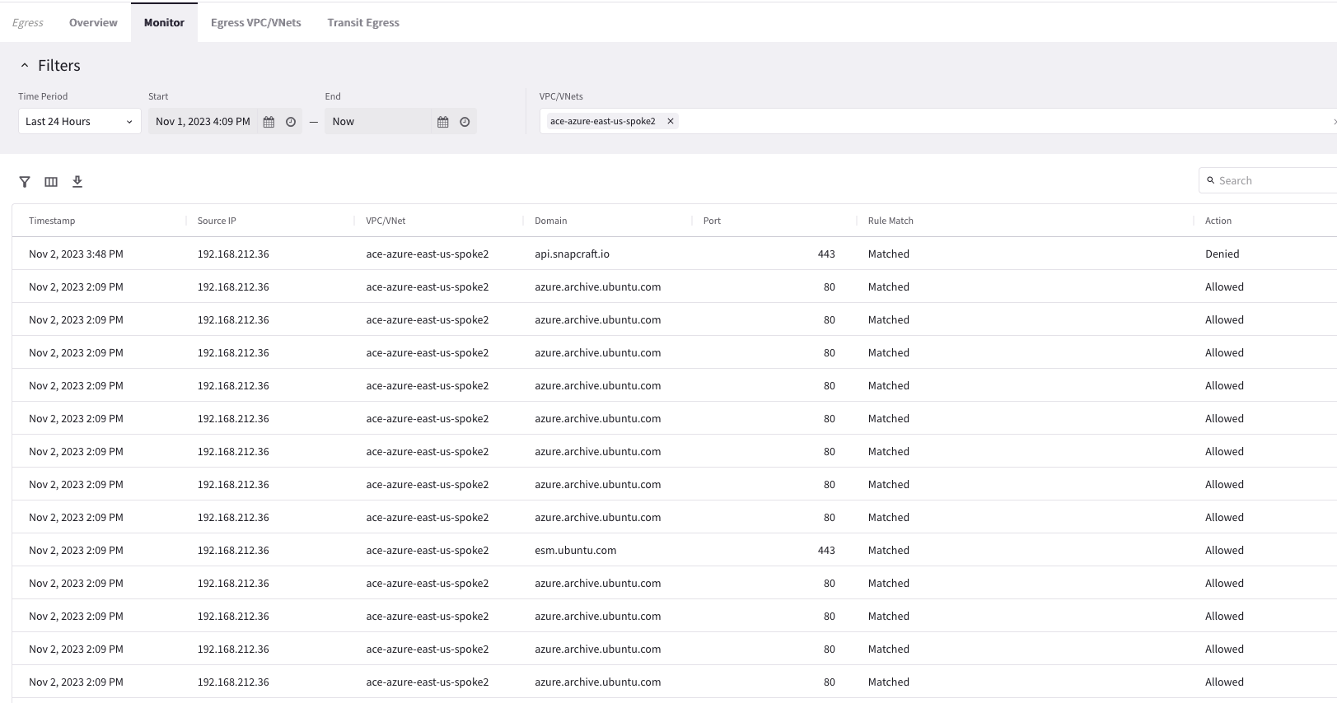
Monitor
CoPilot > Security > Egress > Monitor

Slide 14


Policy as Code Workflow
Sec
Dev
Sec
Security/Firewall Admin creates a SmartGroup, Webgroup and Rule for an app team or VPC.
Notes reason for policy change in Git Commit for future auditing.
Allows Developers to submit Pull requests for Webgroup
Developer redeploys an app – no action necessary as long as it has the same tags
Developer needs to add a FQDN to their Internet Egress - submits a pull request for their Webgroup
Security/Firewall Admin reviews change and merges.
IAC Pipeline automatically deploys the new policy.
Full change log tracked in Git for easy auditability

Slide 15
Next: Lab 7 Secure Egress

